Slide 1
Sync between mepm and mecm
- Vidyashree Rama(v00270735)

Slide 2
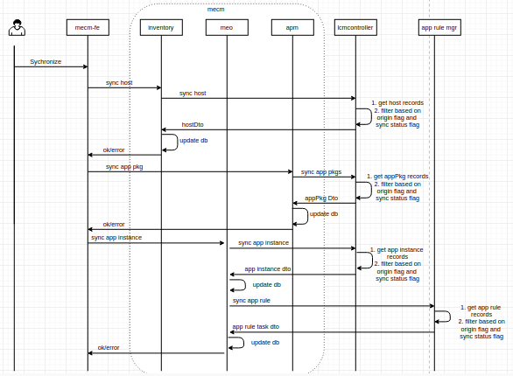
Sync operation – flow diagram

Slide 3
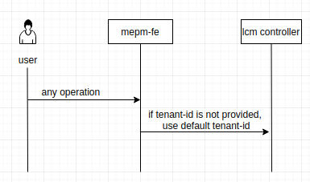
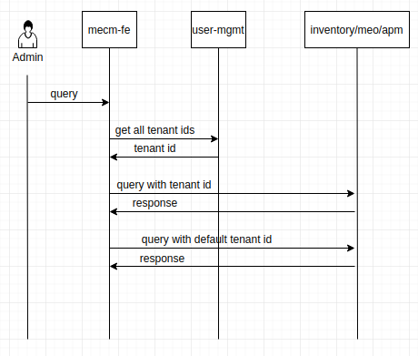
Anonymous user – flow diagram

Slide 4
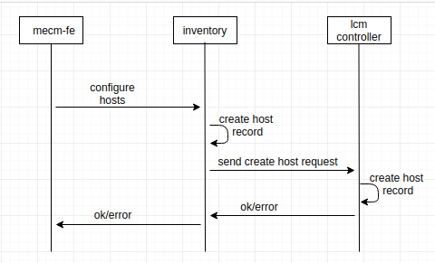
Configure hosts – flow diagram

Slide 5
Tables to be sync

Slide 6
API’s for Sync
No | API | method | RequestBody | Response
1 | /inventory/v1/sync | POST | None | ok/error
2 | /apm/v1/tenant/{tenantId}/appInstances/sync | POST | None | ok/error
3 | /meo/v1/tenant/{tenantId}/appPkgs/sync | POST | None | ok/error
4 | /lcmcontroller/v1/hosts/sync | GET | None | HostDto
5 | /lcmcontroller/v1/tenant/{tenantId}/apppkgs/sync | GET | None | appPkgDto
6 | /lcmcontroller/v1/tenant/{tenantId}/appInstances/sync | GET | None | appInstanceInfoDto
7 | /appruleMgr/v1/tenant/{tenantId}/appInstance/{appInstanceId}/appruletasks/sync | GET | None | appTuleTaskDto

